Slide 1

Social networking task force
Jeff Jaffe
Ann Bassetti
Steve Holbrook
14 May 2012

Slide 2

What we’ve done
Tried to identify specific standards opportunities
Decided we first needed to create an architecture block diagram to show relationships
  Made some progress
Liaison calls with Open Social
Initial ideas on next steps

Slide 3
Human interactions
All contributions merged; no technologies
Sharing / Collaboration
Messaging
Group Dynamics
(e.g., Community, Team)
Collaboration / Newsfeed
Reactions
E-mail like
Comments
Text
Text chat (includes 1:1 and 1:multiple; also includes "Live Chat" such as with Helpline person)
Data structures
Re-share
Create
Document
Subscription
Like / rating
Links
Join / Un-join
Embedding
End / Close
Recommendations
Images
Voice chat
Alerts / Notifications
Tags
Video
Membership list(s)
Video chat
Group list(s)
Audio
Forward / reply (might be part of others or part of 'Sharing")
Tasks
Distribution list(s)
About the human *
Events
Identity
Given/family name
User name(s)
Assigned number(s) (e.g., governmental)
....
Social Graph
Profile
Workflow
Routing
Signatures
Connected objects
Contacts
Profile page ??
Mobile
Ubiquitous attributes
Groups
Profile data
Location
Threading
Sorting (by 'likes', 'most recent',...)
Hyperlinks
Variable device display
Variable security settings
Search
Biz/Mining Intelligence (??)
...
Brands
Presence
Bookmarks
Access control ??
Location
Status
Presence
Microblog
Addressing
snail mail address
email address
URI
Skills
Technical foundations
* Note: professional profile, inside corporate firewall,
is separate from one's personal profile.
Client APIs
Widgets
Analytics
Real-time Notifications
Login credentials
Data structures
Content
'structures'
Wiki
Blog
HTML+
Microblog
JavaScript
Embedded
Engagement
Mobile
Discovery
REST
External
Scoring
Browser
Recommendations
Trends

Slide 4

"Mobile" equilibrium of social network specifications
Laurent Walter Goix contribution
OMA MobSocNet
OpenSocial
OMA Push
OStatus
OExchange
ActivityStreams
WebFinger
Portable Contacts
OpenID
Key
Standardized at W3C
W3C Community Group
Standardized at another body
Standardization candidate
Independent standard group
Public standard
No standards body
Known IP issues
Salmon
Host-Meta
PubSubHubbub
XRD/S

Slide 5
DRAFT
Social headlights task force:
DIAGRAMS, SCENARIOS, ...
Basis set
"Basis Set" = the irreducible list of 5-10 components that are the top-level description of the block diagram
  Example: in the OSI model, the basis set is 7 layers
Initial proposed social networking basis set:
  Identity and addressing (includes profile)
  Data (text, documents, etc.)
  Sharing infrastructure (events, location, status)
  Linking to more information (posting, hyperlinks, search)
  Group dynamics (create groups, membership lists, social graph)
  Transport / messaging
  "Feeds" management
  Reactions
Ann Bassetti
14 May 2012

Slide 6
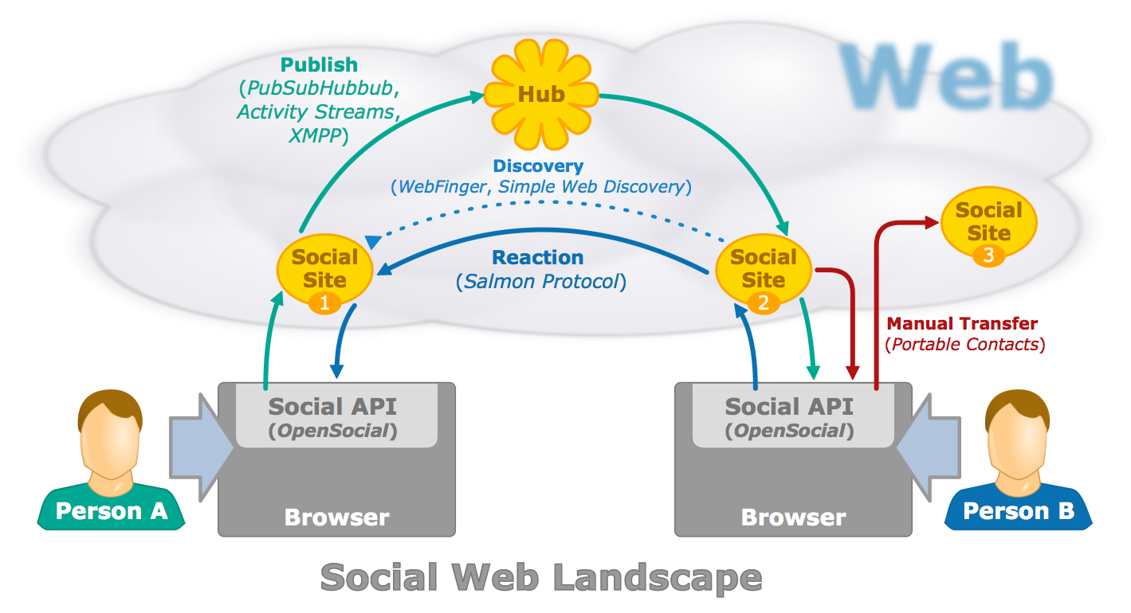
Putting it all together
http://www.w3.org/Talks/Deck/identity/identity-hub-api.svg

Slide 7
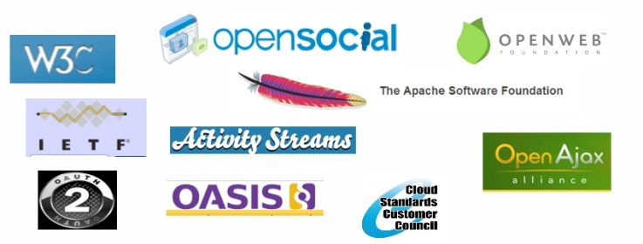
Social Workshop
When: Fall 2012
Where: Bay Area
  possibly co-located with Internet Identity Workshop in Oct
What: Bring together key organizations dealing with Social Standards
  In early discussions re: co-branding
Use headlights project output as catalyst for Workshop
  Use cases & requirements
  explore “boxitecture”
  Explore standards roadmap
Seeking Workshop Sponsors, interested parties

Slide 8
DRAFT
Social headlights task force:
DIAGRAMS, SCENARIOS, ...
Breakout session feedback
Endorse the notion of a jointly sponsored workshop with other standards organizations
Critical to have the correct level of pre-conference preparation
  Identify the priority areas
  Examples: oAuth, Federated Logons, “Like” buttons
  Involve Big players
For browser based social standardization
  Terms and conditions?
    Automatic in browser v user control
Ann Bassetti
14 May 2012

