Slide 1
Tracking Meeting
Khaled El Emam, CHEO RI & uOttawa

Slide 2
Example of De-identification
Simple example to illustrate the key points and terminology
The example is for a health care database
This is based on a methodology that we have been using and modifying for the last 5 years
The objective is risk management – consistent with legislation and regulations across multiple jurisdictions

Slide 3
Case for De-identification
Often, not practical to obtain consent
Disadvantages of consent
Custodians reluctant to disclose information even if permitted
Limiting principles
Data breaches are common
Unplanned and unexpected disclosures
Public trust
Alternatives have disadvantages

Slide 4
Methods of Sharing
Remote access
On-site access
Remote execution
Remote queries
Remote analysis
Tabular data release (aggregate data)
Individual-level data release (de-identified data)
Secure computation

Slide 5
Steps
Understand adversaries and attacks
Select variables that can be used in an attack
Set thresholds taking into account the context
Measure risk
Transform data

Slide 6
Universe of Attacks
Known data recipient:
  Deliberate re-identification
  Inadvertent/spontaneous re-identification
  Data breach
Public data:
  Demonstration attack
The probabilities for each of these can be estimated in a defensible way

Slide 7
Variable Distinctions
Directly identifying Variables
  Can uniquely identify an individual by itself or in conjunction with other readily available information
Quasi-identifiers
  Can identify an individual by itself or in conjunction with other information
Sensitive variables

Slide 8
Examples of Direct Identifiers
Name, address, telephone number, fax number, MRN, health card number, health plan beneficiary number, license plate number, email address, photograph, biometrics, SSN, SIN, implanted device number

Slide 9
Examples of Quasi-Identifiers
sex, date of birth or age, geographic locations (such as postal codes, census geography, information about proximity to known or unique landmarks), language spoken at home, ethnic origin, aboriginal identity, total years of schooling, marital status, criminal history, total income, visible minority status, activity difficulties/reductions, profession, event dates (such as admission, discharge, procedure, death, specimen collection, visit/encounter), codes (such as diagnosis codes, procedure codes, and adverse event codes), country of birth, birth weight, and birth plurality

Slide 10
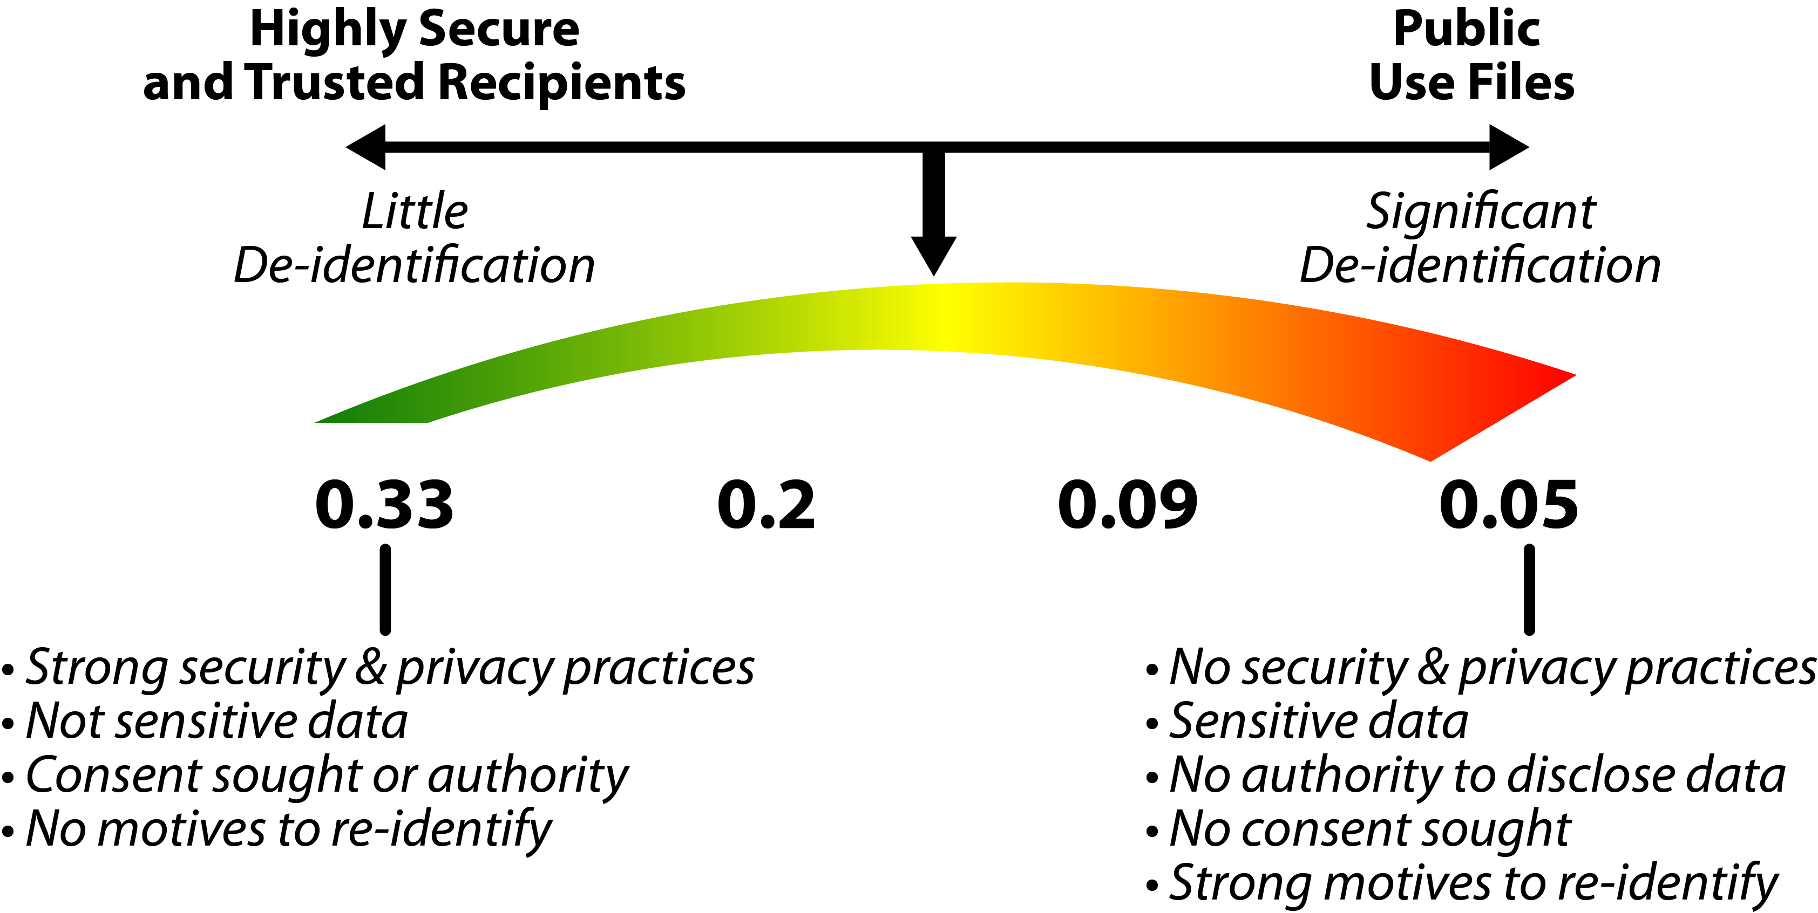
Setting Thresholds

Slide 11
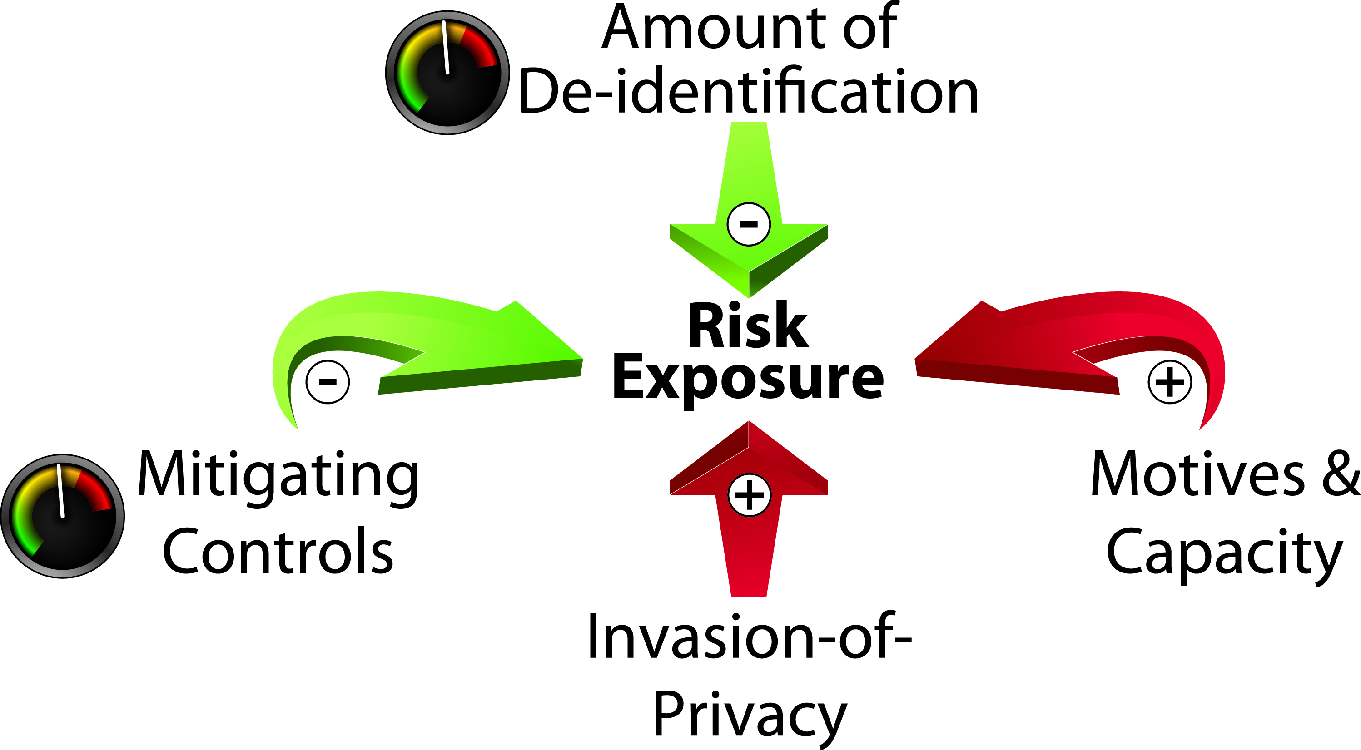
Managing Re-identification Risk

Slide 12
Risk Metrics
There are 8 risk metrics in total characterized along the following dimensions:
  Can an adversary know who is in the database or not ?
  Would an adversary attempt to re-identify a single individual or everyone in the database (matching records from two databases) ?
  Do we need to worry about maximum or average risk ?

Slide 13
Does De-identification Work ?
Existing evidence shows that data sets that have been properly de-identified have a low probability of being re-identified
All publicly known examples of serious re-identification attacks were done on data sets that were not properly de-identified (i.e., it is possible to show that their risk of re-identification was quite high and did not meet HIPAA de-identification standards)
As far as we know, proper de-identification works effectively in managing risk

Slide 14
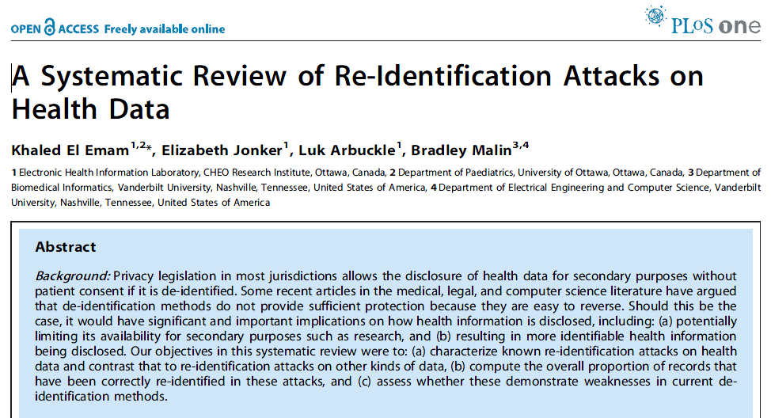
http://www.plosone.org/article/info%3Adoi%2F10.1371%2Fjournal.pone.0028071

Slide 15
Hashing
Hashing without a “salt” or key can generally be broken with a dictionary attack
With salting, you need to figure out who will hold the “salt” – may want to consider schemes with public keys
Even with a salt one can do a frequency attack – may want to consider schemes that are probabilistic
Hash values are not the same size/length as the original data – may want to consider format preserving encryption

Slide 16
Efficient & Secure Lookups
In cases where lookups in a large database need to be performed without the database knowing the value of the query (but knowing the result)
We have used techniques based on homomorphic encryption to implement lookups based on health card insurance numbers (or any equivalent unique identifier)
This class of approaches may be of interest for addressing some of the tracking problems

Slide 17
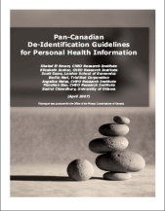
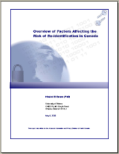
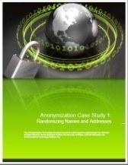
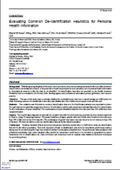
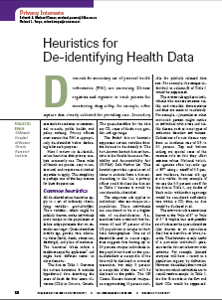

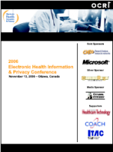
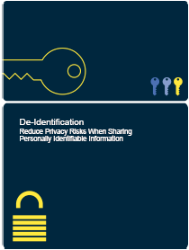
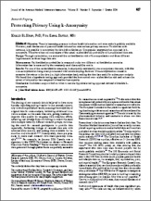
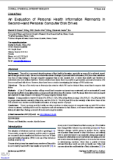
www.ehealthinformation.ca
kelemam@uottawa.ca
www.ehealthinformation.ca/knowledgebase

